Slide 1
Pokerbots 2023
Lecture 6: Advanced Topics

Slide 2
Announcements

Slide 3
Final Tournament & Sponsor Networking:
Friday, February 3rd

Slide 4
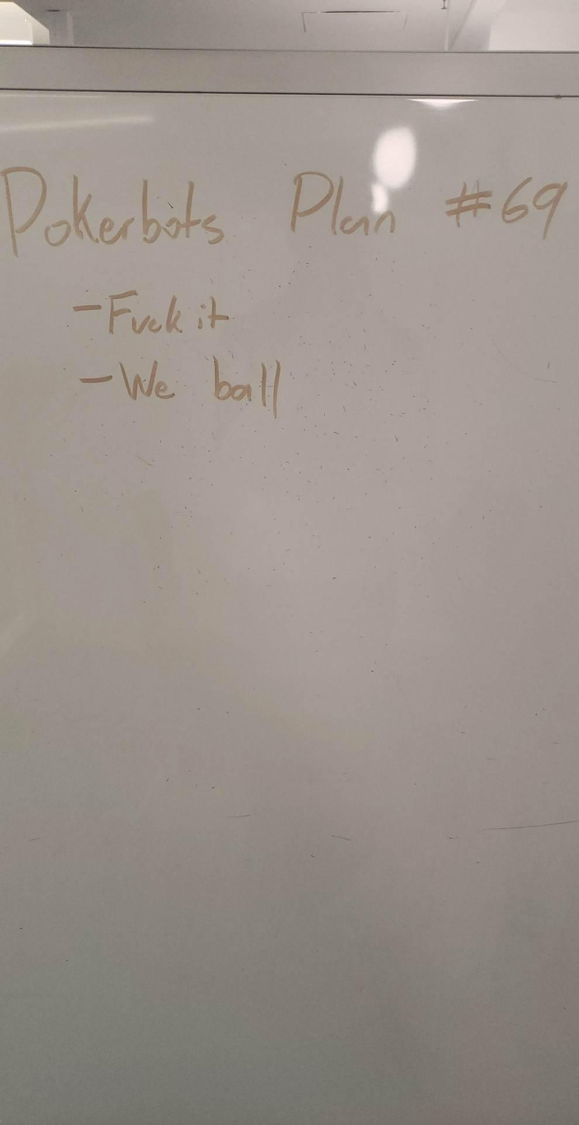

Slide 5
Tournament 2

Slide 6
WINNER:
Calling Station

Slide 7
Giveaway

Slide 8
5th submission wins!
pkr.bot/raffle

Slide 9
Agenda
Machine Learning
Reinforcement learning
Goals and fundamental challenges
Q-learning
CFR
Neural networks
CFR bot with Tic Tac Toe

Slide 10
Machine Learning

Slide 11
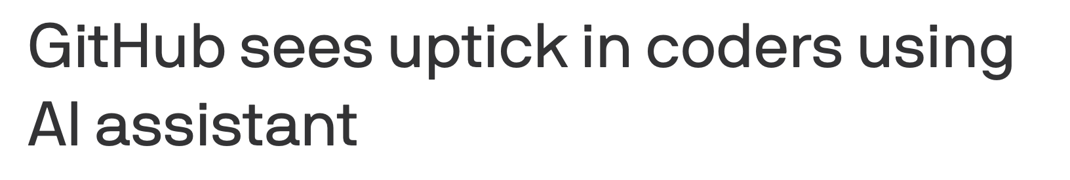
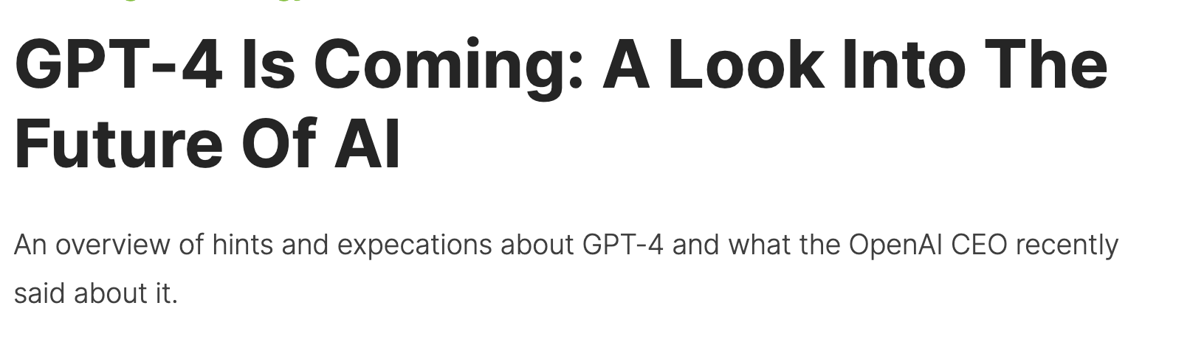
The next big thing

Slide 12
Buzzwords
Deep learning neural networks for intelligent big data analytics with business-to business automated artificial intelligent blockchains in the cloud!
...it’s really much more simple

Slide 13
Learning
Machine learning (ML) algorithms complete a process or task, but they get better at completing that task with experience. At a certain point, they can become good enough to handle the task with near perfect accuracy!
Prediction
Decision Making
Automation

Slide 14
General workflow
ML techniques need experience to improve. That experience mainly comes from either looking at data or trying a new task over and over again. This is called training.
Typical training plan:
Start with a simple strategy
Take in experience
Look at a data point, try something new, etc.
Learn something from that experience
Update our strategy and repeat...

Slide 15
Areas of ML
Typical algorithms used in ML fall generally into three categories:
Supervised Learning
We show our algorithm many input and output examples
Unsupervised Learning
We ask our algorithm to recognize patterns without telling it the right answer
Reinforcement Learning (RL)
Our algorithm learns from an environment and tries to get some “reward”

Slide 16
Supervised learning example
We love cats and birds!
We want our algorithm to take a photo and tell us if it’s a cat or a bird
We have example photos and labels of both
Let’s train a model on our example photos!

Slide 17
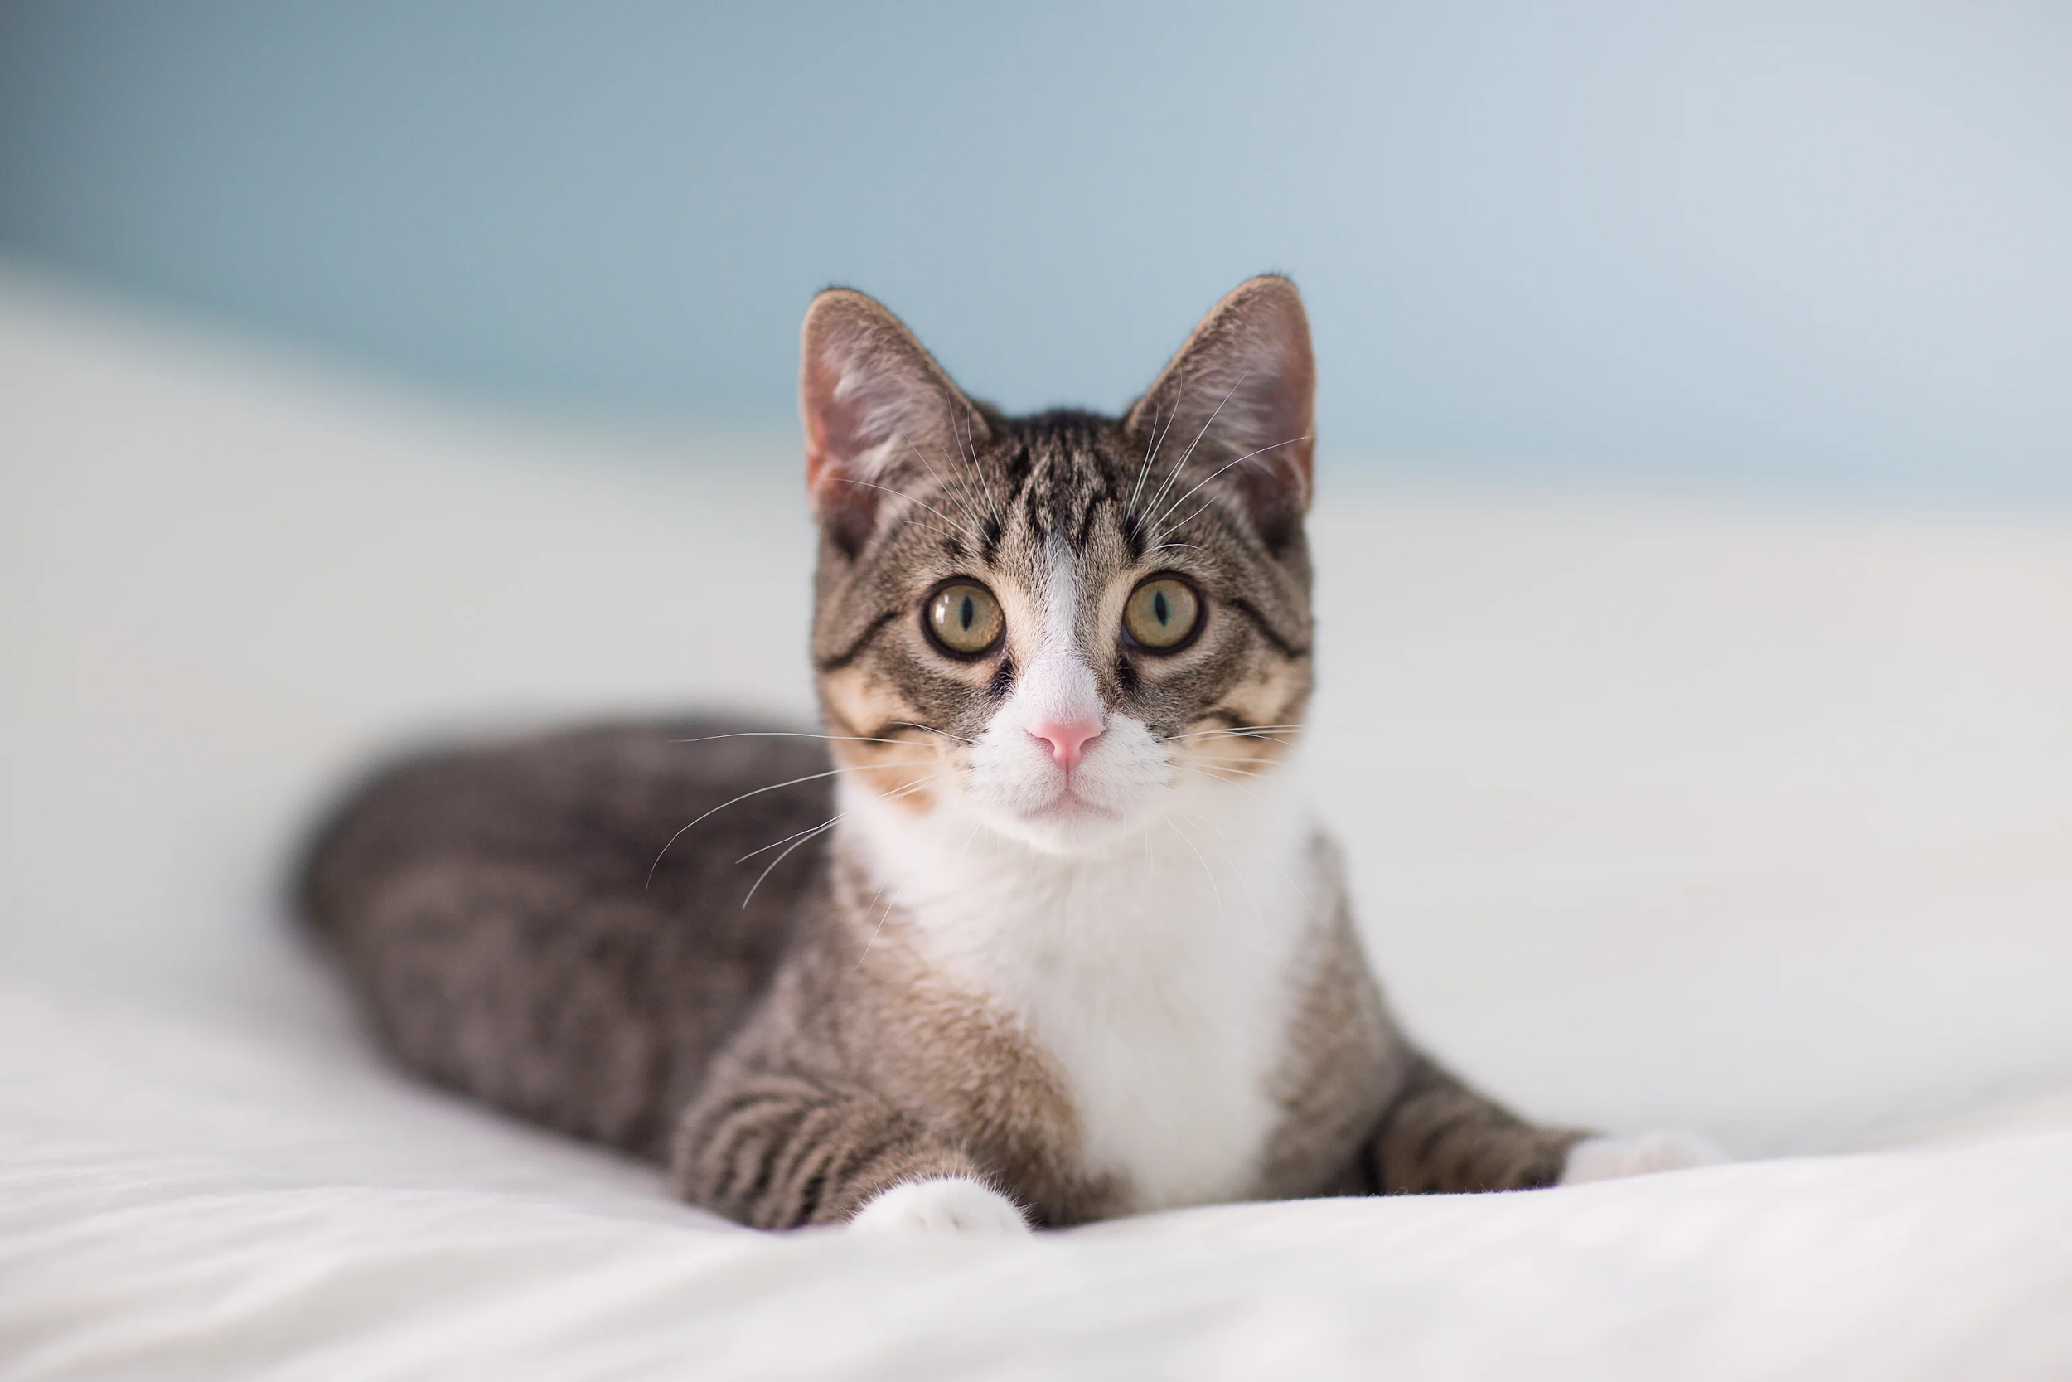
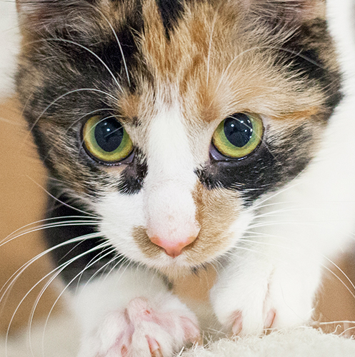
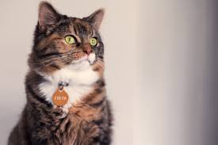
Supervised Learning: Training
“Cat”
Data
“Cat”
Labels
“Cat”

Slide 18
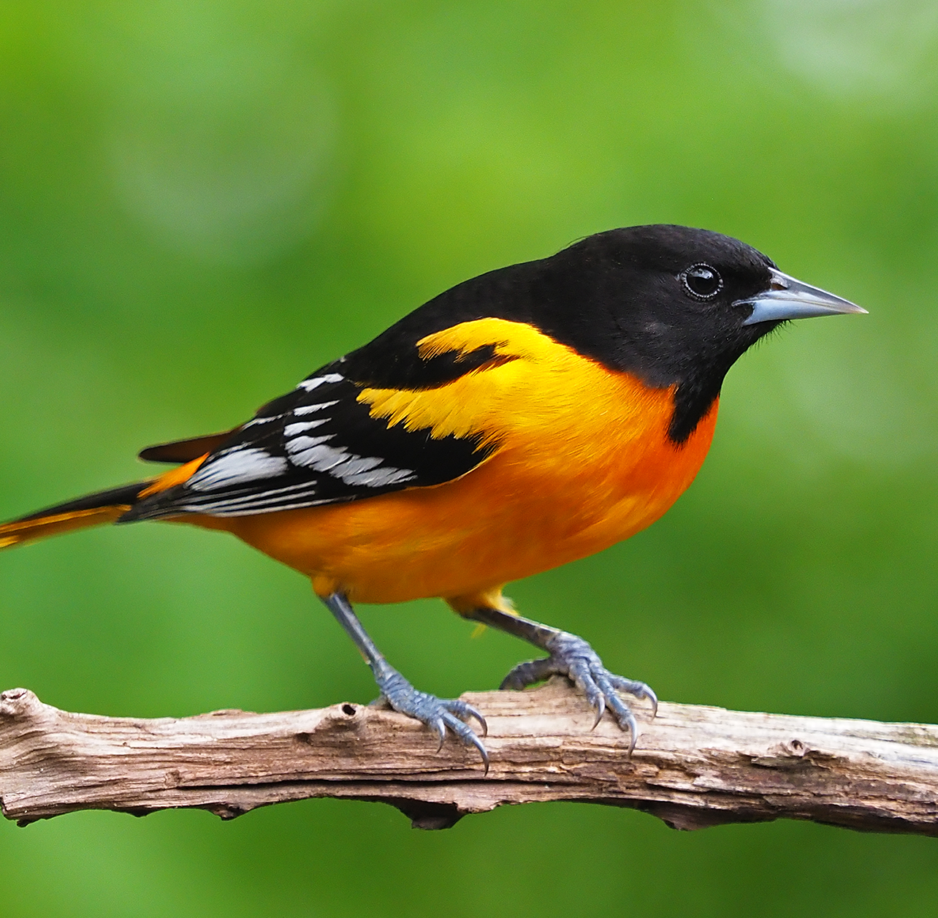
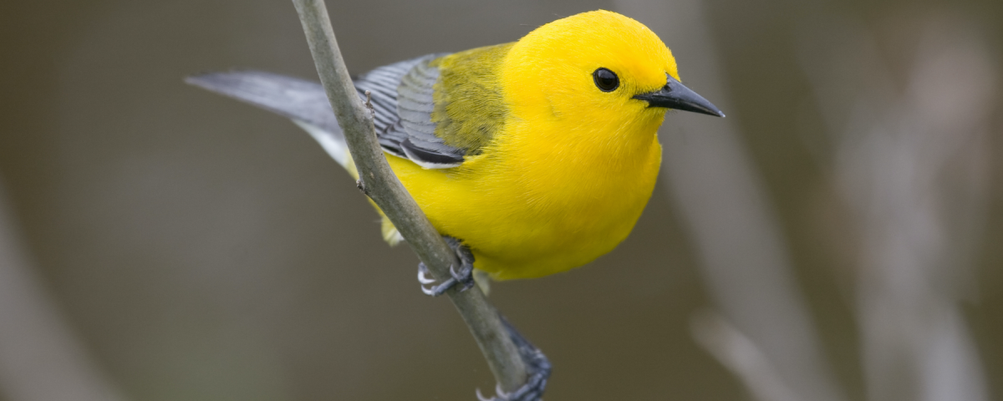
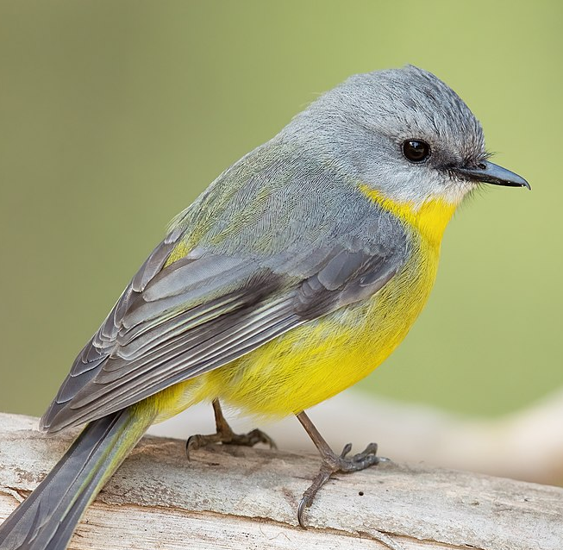
Supervised Learning: Training
“Bird”
“Bird”
“Bird”

Slide 19
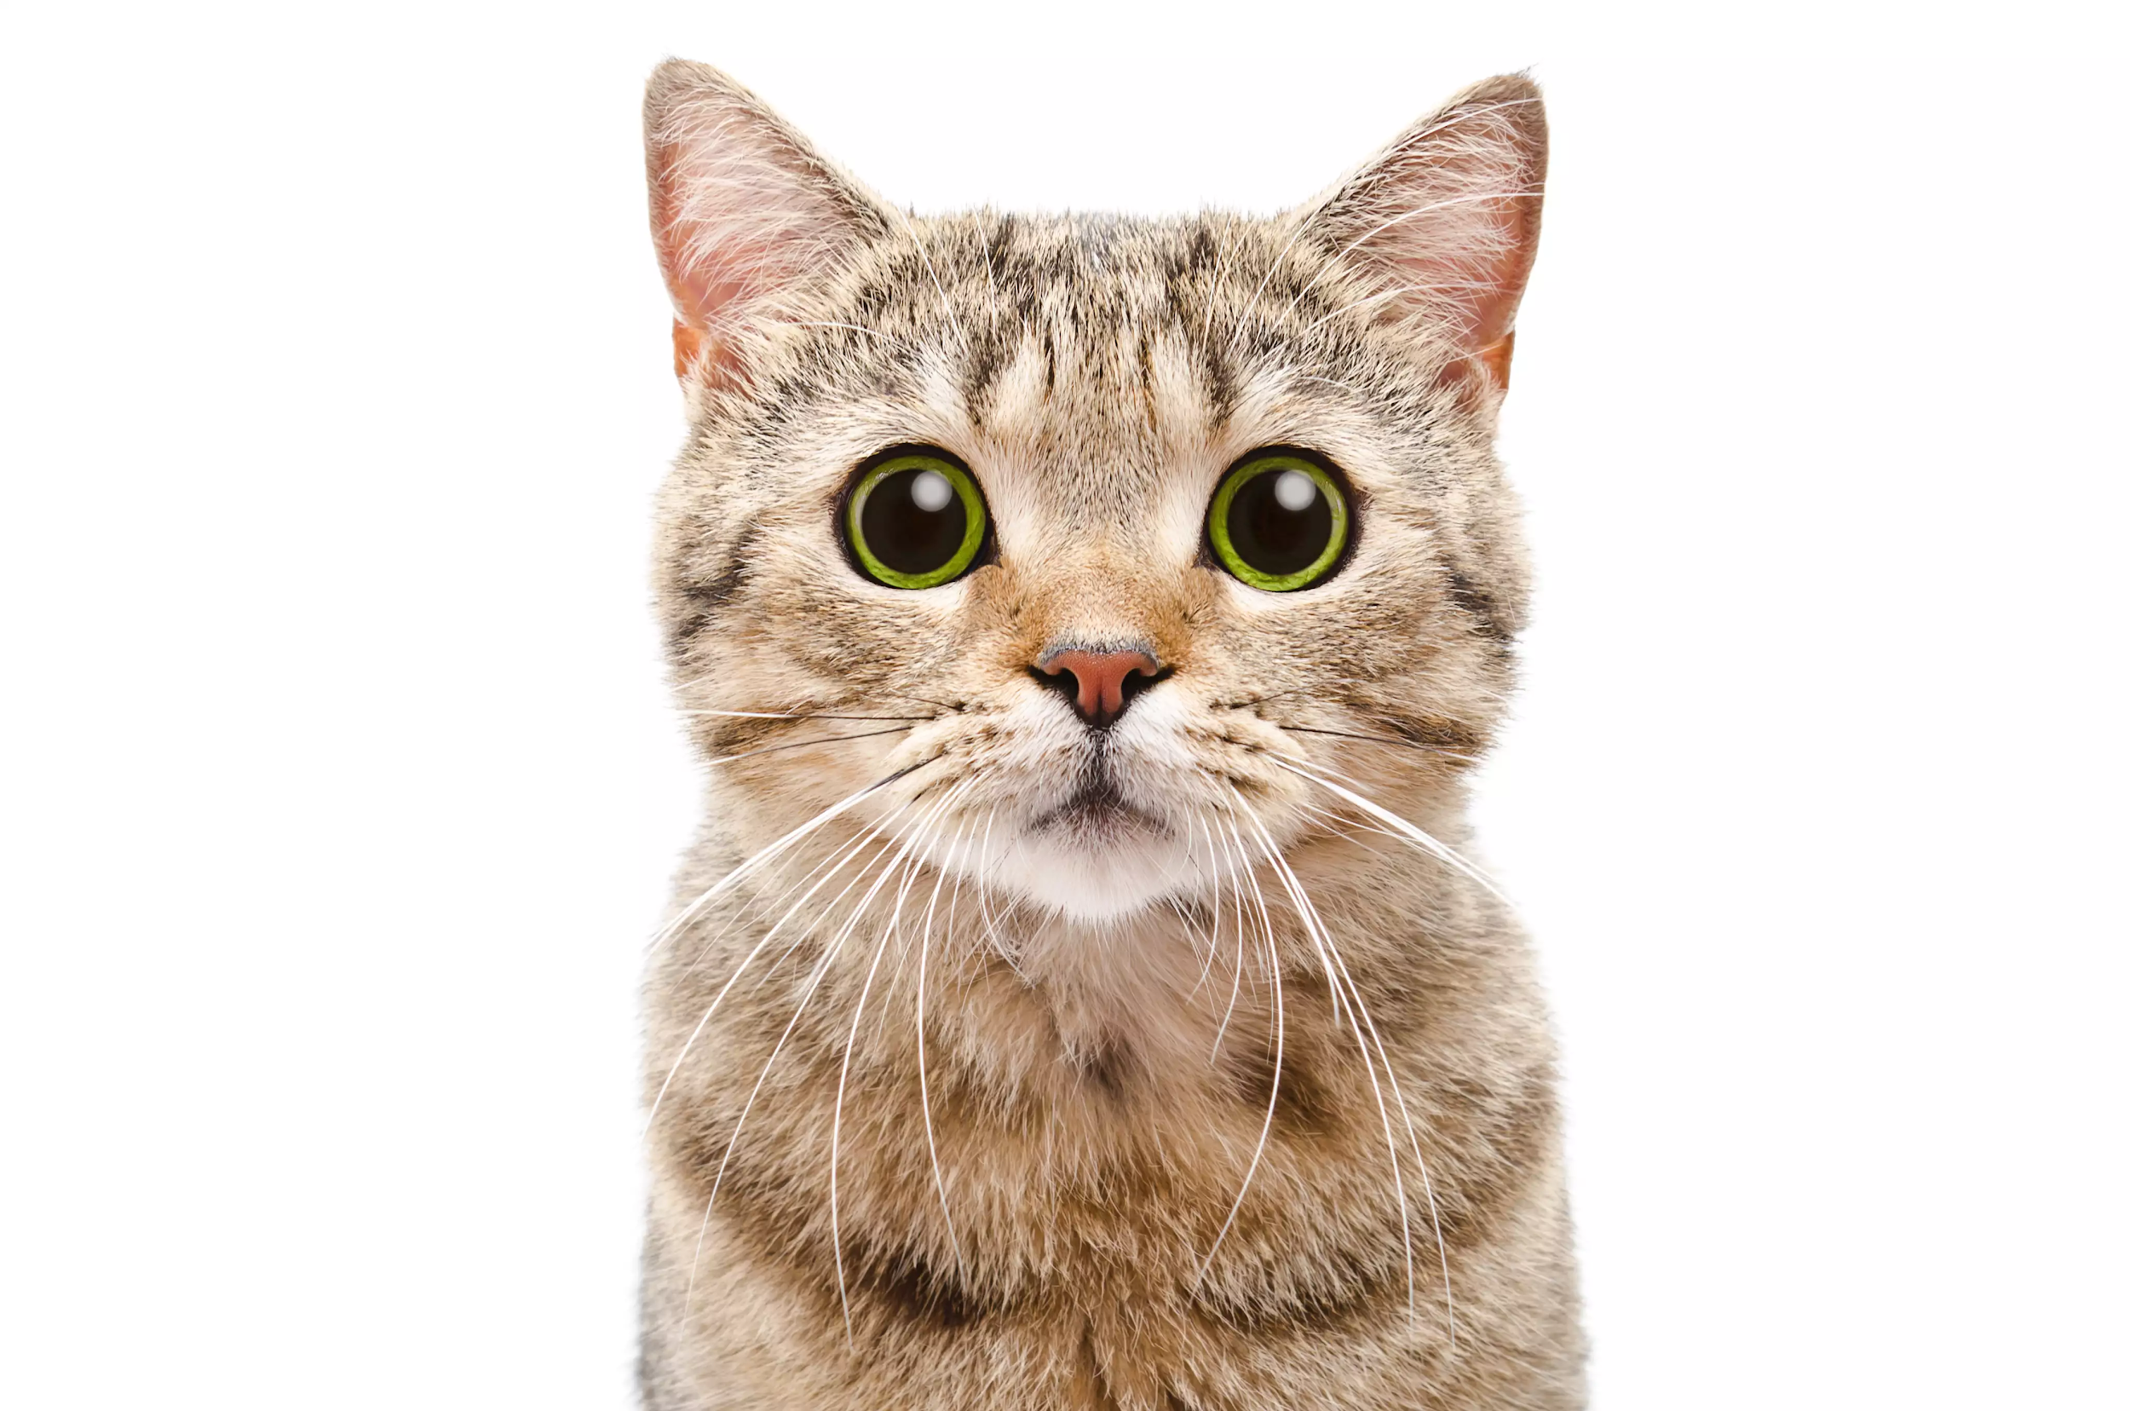
Supervised Learning: Prediction
https://mit.zoom.us/j/99610361734
https://mit.zoom.us/j/99610361734
Cat or Bird?

Slide 20
Supervised learning algorithms
There are many algorithms that can do this kind of thing!
Neural Networks
Decision Trees
Regression
Support Vector Machine (SVM)

Slide 21
Unsupervised Learning
Group these by similarity...

Slide 22
Unsupervised Learning
Group 1
Group 2

Slide 23
Unsupervised learning algorithms
A lot of clustering and general data analysis
k-means clustering
k-nearest neighbors
Expectation - Maximization Algorithm (EM)

Slide 24
What about a Pokerbot?
We can certainly use techniques from supervised and unsupervised learning for River of Blood Hold’em:
Predict the strength of our cards
How we should play on the Run
But we may benefit more from another machine learning area...

Slide 25
Reinforcement Learning

Slide 26
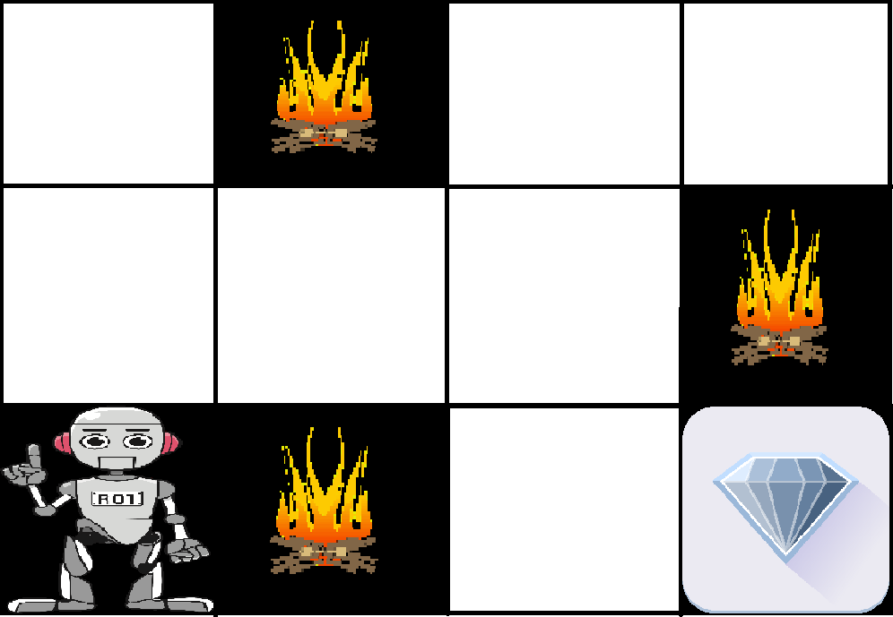
Reinforcement Learning (RL): an overview
An agent takes actions to move between states, with the goal of maximizing reward
The agent has multiple attempts to learn an effective policy (strategy)
Examples: self-driving cars, robotics, poker
Poker framework
Reward: chips
States: the different betting rounds
Decisions: Check, Call, Raise, Fold, etc.

Slide 27
Successes
AlphaZero: trained entirely from self-play
Beat best-in-world chess engine starting from only the rules of the game
DeepMind “parkour” paper:
Inputs: terrain map, joint angles, angular velocities
Reward: forward progress

Slide 28
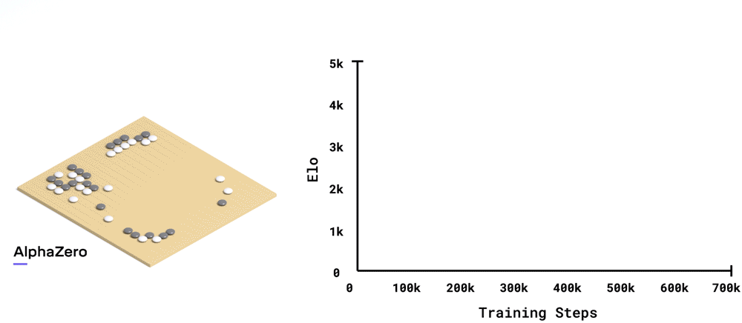
AlphaZero: from zero to mastery in four hours

Slide 29
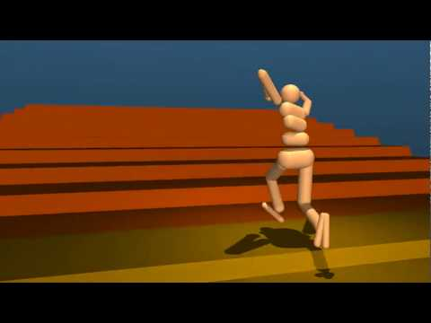
Parkour

Slide 30
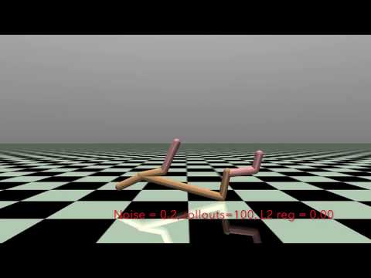
Why don’t we all use reinforcement learning?
Hard to train
Sensitive to parameters
Escaping local optima
Sample inefficient

Slide 31
5000
Number of processors needed to generate self-play games for AlphaZero’s training

Slide 32
6400
Number of CPU-hours needed to train DeepMind Parkour

Slide 33
Struggles with multi-agent scenarios
In chess, if bot1 loses to bot2 and bot2 loses to bot3, then there is a good chance that bot3 is the strongest chess player
Gives a clear route to iterated improvement
This is far from guaranteed in poker

Slide 34
Return to rock-paper-scissors
When two reinforcement learning agents are trained against each other, they get very good at beating each other
Risk of getting caught in a policy cycle without making meaningful improvements to performance
Hero: rock ⟶ villain: paper ⟶ hero: scissors ⟶ villain: rock ⟶ hero: paper ⟶ villain: scissors ⟶ hero: rock…
Cycles are predictable, which is undesirable

Slide 35
What to reward?
Designing a good reward function is hard
In poker, the job is done for us
Example: reinforcement-learning Tetris
Misbuilt reward function led to the agent to pause the game when it was about to lose

Slide 36
Suppose we’ve considered all the warnings…
Well-crafted reward function
Clear goal in mind for our policy
Sufficient compute resources
Handling multi-agent scenarios
How do we train our policy?

Slide 37
Q-learning

Slide 38
Q-learning intuition
Let’s return to thinking of poker as a multi-step process
Extensive form instead of matrix form in the game theory lecture
Q-learning is a sample-based, one-agent way to tabulate the game states of this process and the quality of each action we could take in any given game state

Slide 39
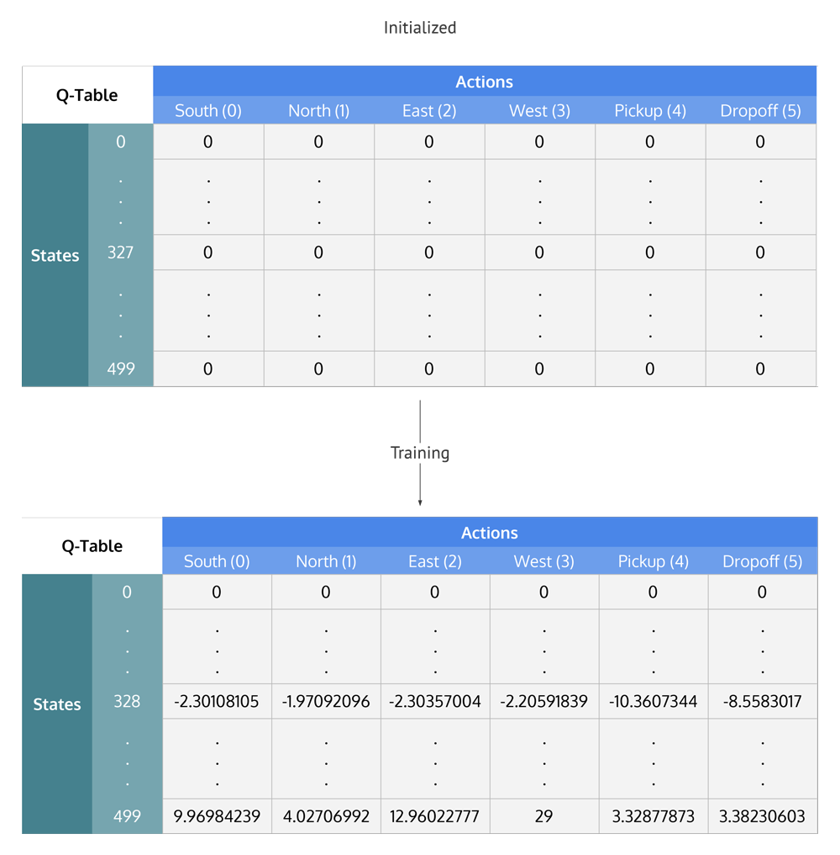
Q-table

Slide 40
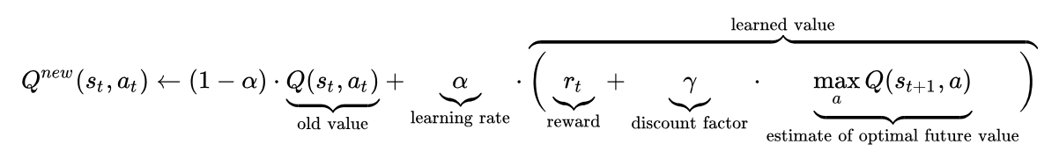
Update rule

Slide 41
The upsides of Q-learning
General: Q-learning can learn a policy to maximize final reward even if rewards happen incrementally
Simple and intuitive: we repeatedly play games, and we take the deterministic action with the highest quality (do what worked well in the past)
Theoretically sound: for any finite Markov decision process, Q-learning finds a policy that maximizes expected reward

Slide 42
Finite Markov decision process?
Perfect information games: chess, Go
Video games: Tetris
Games with randomness: Monopoly

Slide 43
Partial observability
Ordinary Q-learning is not guaranteed to work for imperfect information games:
Poker against an opponent with a fixed strategy
Trading
Liar’s dice

Slide 44
More downsides
Slow to converge
Prone to getting stuck in local optima
Intractable if the state space is too large
What do we do?
Use neural networks as an approximation
Use a specialized algorithm for large, imperfect information games

Slide 45
Counterfactual Regret Minimization
(CFR)

Slide 46
Regret-matching
RPS: We play rock, opponent plays paper
Regrets: 0 for rock, +1 for paper, +2 for scissors ⟶ (0, 1, 2)
Mixed strategy: (r=0, p=1/3, s=2/3), opponent plays scissors
Value: -1/3 for our mixed strategy, 1 for rock, -1 for paper, 0 for scissors
New regrets: (4/3, -2/3, 1/3), new cumulative regrets: (4/3, 1/3, 7/3)
New mixed strategy: (r=1/3, p=1/12, s=7/12)
New average strategy: (r=1/6, p=5/24, s=5/8)
Notes:
Worked example is from gettysburg AI
Idea for learning RPS against some opponent: dont just switch to best response right away. Instead add some uncertainty
Turns out we need to average strategy over time

Slide 47
Averaging our regret-matching strategy
Compute a mixed strategy for each player by matching cumulative regrets. (If all cumulative regrets for a player are non-positive, use a random strategy.)
Select each player’s action by sampling from their strategy.
Update cumulative regrets.
Repeat T times.
Return the average mixed strategy across the T iterations.
Notes:
Prev can be exploited. This one can’t. Mention self-play

Slide 48
Counterfactual regret
Instead of matching regret, we match counterfactual regret
For a node n, counterfactual regret answers the question: what would n’s value change to if I picked some pure action a?
Value for a node n: values of n’s children multiplied by the corresponding action probabilities (according to n’s counterfactual regret-matching strategy)
Goal: regret-matching algorithm on the game tree

Slide 49
Monte Carlo CFR algorithm
Fix all random actions for a game.
Construct an entire game tree given the fixed random actions and each players’ regret-matching strategies. Each node is weighted by its likelihood under the players’ strategies. (Randomness is weighted implicitly by the first step.)
Compute counterfactual regrets at each node.
Run regret-matching to get new mixed strategies for each player.
At the end, use the average strategy to play poker.

Slide 50
Problems and extensions
The bucketing problem: how can we reduce the size of the game tree?
Bot size limits
Extensions: CFR+, linear strategy weighting, external sampling
http://modelai.gettysburg.edu/2013/cfr/index.html
Notes:
Bucketing: edges of buckets will be fucked.
Sampling both chance and player actions?
-variance reduction (David Shin)
-CFR+

Slide 51
Neural Networks

Slide 52
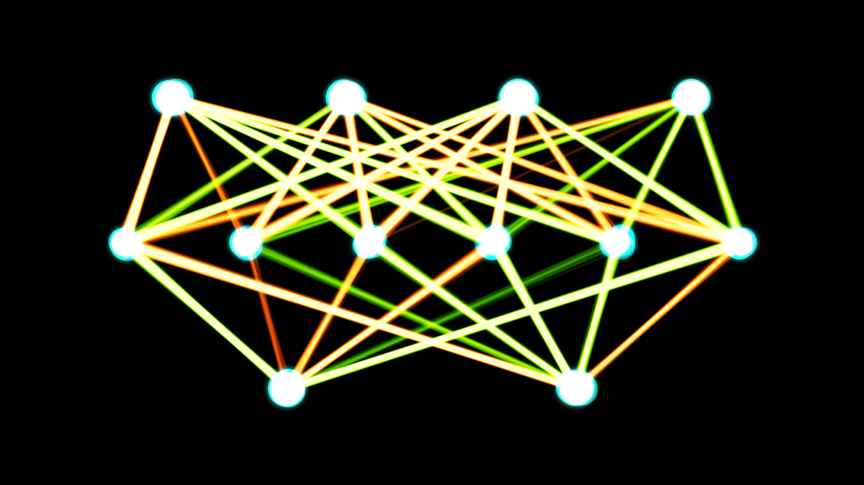
What is a neural network?
Multilayer perceptron?

Slide 53
What is a neural network?
Multilayer perceptron?

Slide 54
Yes, but…
A more practical way to think of neural networks is as one of the most empirically successful ways to approximate a function based on a limited number of input-output pairs
They come in many shapes and sizes, with bigger networks being more expressive, i.e. better able to approximate complicated functions
What makes them successful?
Ability to generalize to unseen data

Slide 55
What uses neural nets?
Image and speech recognition
Recommender systems
AlphaZero
DeepMind parkour
A Q-table is a function that we can approximate: deep Q-learning
DeepStack

Slide 56
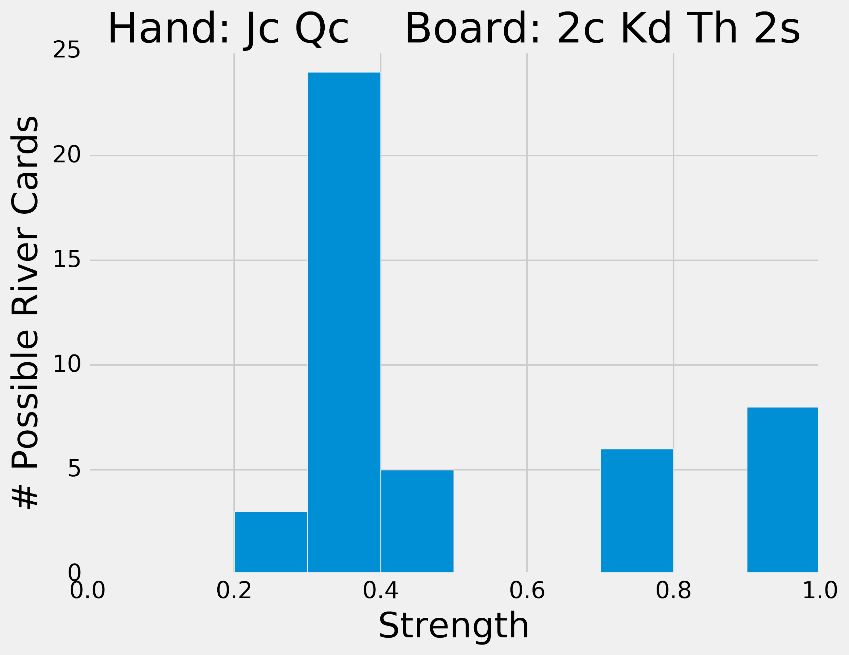
Neural networks and poker
Lots of functions could be worth approximating:
Game state ⟶ strategy (distribution over actions)
Private cards and board cards ⟶ final hand strength curve
Starting cards ⟶ best Blotto allocation
Game state ⟶ CFR bucket

Slide 57
Proceed with caution
Central problem: how do I train?
Need high-quality input-output pairs
If I take samples from the scrimmage server, then I am approximating my opponents, which makes it less likely that I’ll beat them
If my samples are against a fixed strategy, then I will learn how to beat that one strategy but not how to play poker well
If I play two neural nets against each other, then who knows if they will converge or get caught in cyclic behavior

Slide 58
CFR Tic Tac Toe

Slide 59
Giveaway Winners!

